Slide 1

Common Neurosurgical Pathologies In The Elderly
Dr H. BOODHOO
F.C.S (Neurosurgery)

Slide 2
With a growing percentage of the population reaching over 65 years, the burden of neurological disorders is increasing

Slide 3
United Nations Report
Up to 1 billion people, nearly one in six of the world population suffers from neurological disorders and 6.8 millions death occurs each year
One out of three people will be affected by a neurological disease at some point in their life.
Over 400 diseases are classified as neurological diseases.

Slide 4
Neurological disorders are the leading cause of disability and second leading cause of death worldwide.
The six big causes are Parkinson’s disease, Epilepsy, Alzheimers, Stroke, Headache disorders and Neuro-infections.

Slide 5
Neurological Pathologies in the elderly
Dementia
  Alzheimer disease
  Normal Pressure Hydrocephalus
  Senile Dementia
  Multi Infarct Dementia
Epilepsy
Neoplasms
Headache disorders
Multiple Sclerosis
Neuro Infections
Neurological Disorders associated with malnutrition

Slide 6
Neurological Pathologies in the elderly (cntd)
Pain associated with neurological disorders
Parkinson disease
Stroke
Traumatic Brain Injury (Chronic Subdural Haematoma)
Depression
Spinocerebellar degeneration
Spinocerebellar degeneration due to alcohol

Slide 7
COMMON NEUROSURGICAL PATHOLOGIES IN THE ELDERLY
NORMAL PRESSURE HYDROCEPHALUS
CHRONIC SUBDURAL HEMATOMA

Slide 8
NORMAL PRESSURE HYDROCEPHALUS I
Triad of
Dementia
Urinary incontinence
Gait disturbance
(ventricular dilation with normal opening pressure)

Slide 9
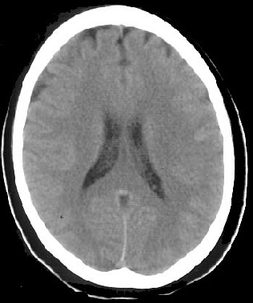
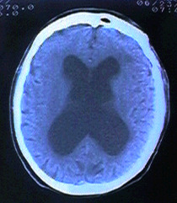
COMPARISON
Normal
NPH

Slide 10
Study of NPH Risk Factors in Nursing Home Patients
N = 180 Patients
Incontinence 75.3%
Non-ambulatory 86.0%
Dementia 45.9%
Depression 46.5%
J. Neurosurg. 2006

Slide 11
NPH Clinical Diagnostic Criteria
Major criteria:
1. Ventriculomegaly
2. Movement disorder: with one or more of the following features:
a. magnetic / shuffling gait
b. abnormal standing base
c. bradykinesia
d. Limb apraxia
e. retropulsion
f. hypometric turning
g. forward leaning posture
h. decreased manual dexterity

Slide 12
3. Incontinence: with at least one of the following features:
a. Urgency
b. Frequency
c. Indifference
4. Cognitive Impairment: with one or more of the following features:
a. attentional impairment
b. diminished insight
c. impaired learning and recall
d. behavioral alterations

Slide 13
Combination of Clinical Symptoms
Memory Only (3.3%)
Gait Only (10.6%)
Memory & Incontinence (4.6%)
Gait & Incontinence (3.3%)
Triad (57.6%)
Gait & Memory (20.5%)

Slide 14
The Three Stages of INPH
Stage 1 Developing
Symptoms
Stage 3
Refractory to
Treatment
Stage 2 Therapeutic Window
Time

Slide 15
NORMAL PRESSURE HYDROCEPHALUS II
(Pathophysiology)
Dilated ventricles impair perfusion
Hypoperfusional states mainly in the
frontal lobe, basal ganglia and thalamus
Classical symptomatology

Slide 16
NORMAL PRESSURE HYDROCEPHALUS III
Frontal lobe
Personality change
Anxiety
Depression
Psychiatric symptoms like delusional states, Hallucinations and aggressive states
Obsessive compulsive disorders
Othelo syndrome,
Shoplifting and mania
Thalamic Symptoms: - are characterised by apathy, Othello syndrome
Basal ganglia : - chorea

Slide 17
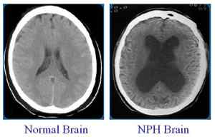
COMPARISON

Slide 18
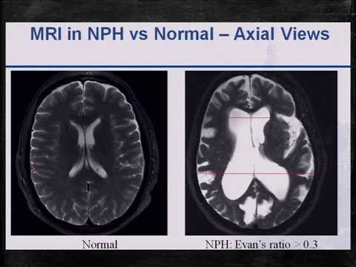

Slide 19
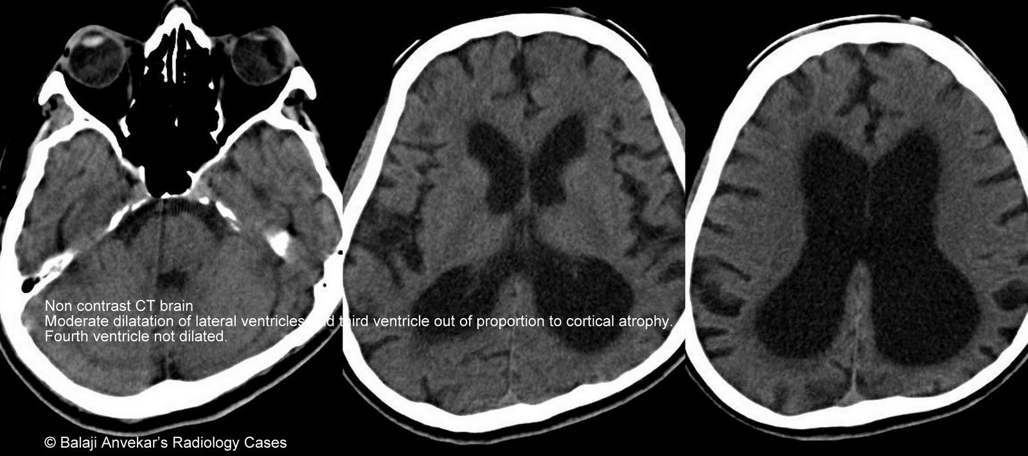

Slide 20
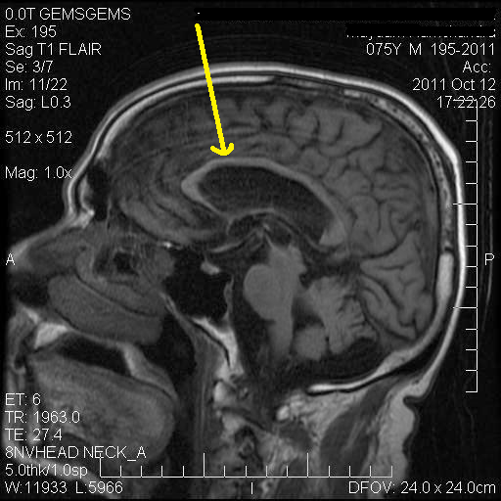
Thinning of Corpus Callosum

Slide 21
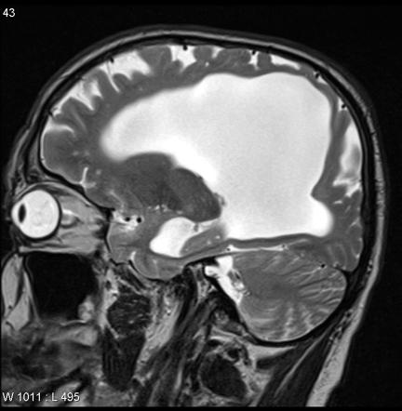
CSF Flow Void in Aqueduct

Slide 22
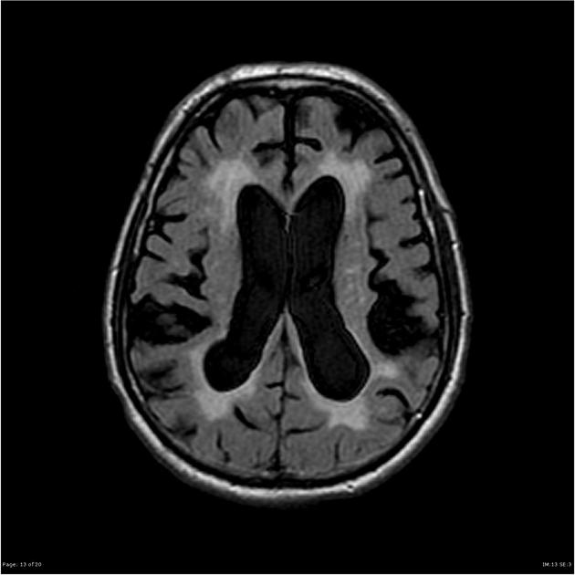
Periventricular Hyper intensity (CSF Sepage)

Slide 23
Protocol for NPH Patient
Clinical Evaluation (Outpatient)
(1) Symptom; Gait Disturbance, Memory Loss, Urinary Incontinence
(2) Radiological Finding; Head CT, MRI, Spinal MRI, Spectroscopy
Clinical Diagnosis of NPH
Infusion Study
Tap 30 cc
Improve after Tap at 30 Min
Non-improve after Tap at 30 min
Shunt programmable valve
Follow

Slide 24
NORMAL PRESSURE HYDROCEPHALUS IV
NPH is a reversible cause of dementia
It is largely underdiagnosed
It is crucial for the psychiatrist to identify atypical cases and to do early imaging and early referal

Slide 25
CHRONIC SUBDURAL HEMATOMA I
Incidence
2/100,000 per yr (60-70 years)
8/100,000 per yr (70-80 years)

Slide 26
Chronic Subdural Hematoma (CSDH)
Definition
Defined as chronic (≥ 3 weeks)
Bleeding is between the dura matter (which adheres to the skull) and the arachnoid matter (which envelopes the brain).
Cause – Traumatic Tearing of the bridging veins which connect the brain surface with the dura matter

Slide 27
Epidemiology
Incidence 1.7-18 per 100, 000 people
Increase up to 58 per 100, 000 people above the age of 65
Men – 64%, Woman- 33%
77% history of trauma
41% oral anticoagulants or platelet inhibitors

Slide 28
Risk factors
Advanced age
Alcohol abuse
Seizures
CSF Shunts
Coagulopathies
Patient at risk for falling (hemiplegia)
20-25% bilateral
Head injury
Drugs (Anticoagulant/antiplatelets drugs)
Low intracranial pressure
Hemodialysis

Slide 29
Risk Factors
Repeated coughing, sneezing
Weight Lifting, blowing into instruments
Rapid repetative head movements
Rotational acceleration (Roller Coasters)
  Deformation of the brain, diffuse axonal injury
  Tissue tears and vascular disruptions

Slide 30
Theories
Osmotic Theory
Oncotic Theory
Microbleeds theory
Anticoagulant and profibrinolutic theory
Inflammatory and growth factors theory

Slide 31
Radiological Classification
Internal architecture of the hematoma, corresponding to possible stages in the natural history of CSDH
(Nakaguchi & colleagues, 2001)
Homogeneous type
Laminar type
Separated type
Trabecular Type
Recurrence rate was shown to be lower in the Homogeneous and Trabecular type.

Slide 32
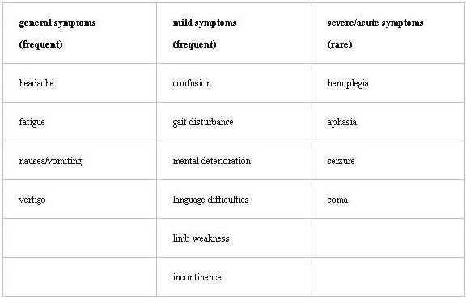
Clinical Presentation

Slide 33
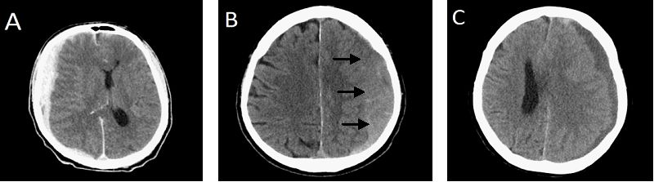
CT images with an acute SDH, <3 days old, hyperdens (A), subacute SDH, 3 days to 3 weeks old, isodens (B), and cSDH, >3 weeks old, hypodens (C)

Slide 34
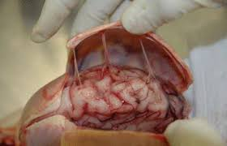
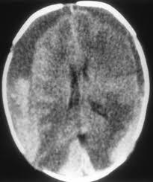
CHRONIC SUBDURAL HEMATOMA II

Slide 35

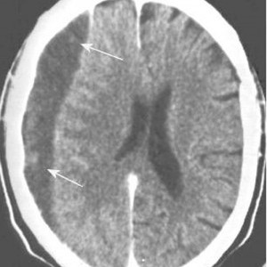
CHRONIC SUBDURAL HAEMATOMA

Slide 36
COMMON PRESENTATION I
Altered mental state
Confusion
Drowsiness
Coma
Delirium
Depression
Paranoid symptoms

Slide 37
COMMON PRESENTATION II
Focal neurological deficit (hemiparesis-58 %)
Headache- 15-60 %
Seizures -6 %
Transient neurological deficit
History of head injury is present in only 30-50 % cases

Slide 38
CHRONIC SUBDURAL HEMATOMA
Symptoms can easily be misattributed to alcoholism or dementia
40 % patients -misdiagnosed

Slide 39
CHRONIC SUBDURAL HEMATOMA
CHRONIC SUBDURAL HEMATOMA
Study of 79 patients, mean age 69 years
Preoperative symptoms
Cognitive impairment 54%
Headache 43%
Hemiparesis 31%
Dysarthria 20%

Slide 40
CHRONIC SUBDURAL HEMATOMA
Is an important differential diagnosis for dementia and neurodegenerative diseases
is an important reversal cause of dementia in elderly
Early neuro-imaging is necessary

Slide 41
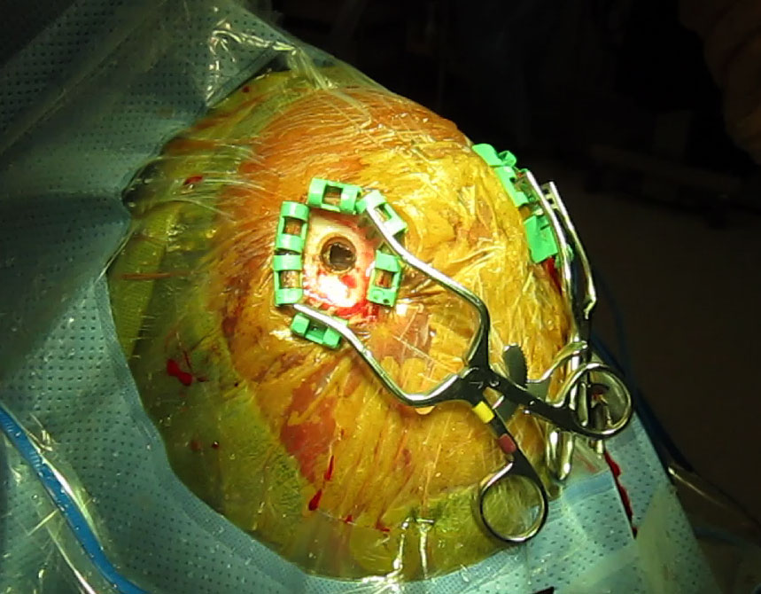
BURR HOLE DRAINAGE OF CHRONIC SUBDURAL HEAMATOMA
Burr Hole

Slide 42
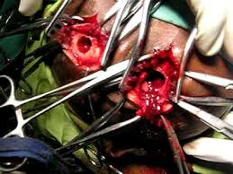
CHRONIC SUBDURAL HEMATOMA
(Multiple Burr Holes)

Slide 43
Mini-Craniotomy
Advantages
Difficult to visualise the septations, vessels, and the psedo-inner membranes.
Re-expansion of the brain
Re-establishment of the normal brain interstitial flow

Slide 44
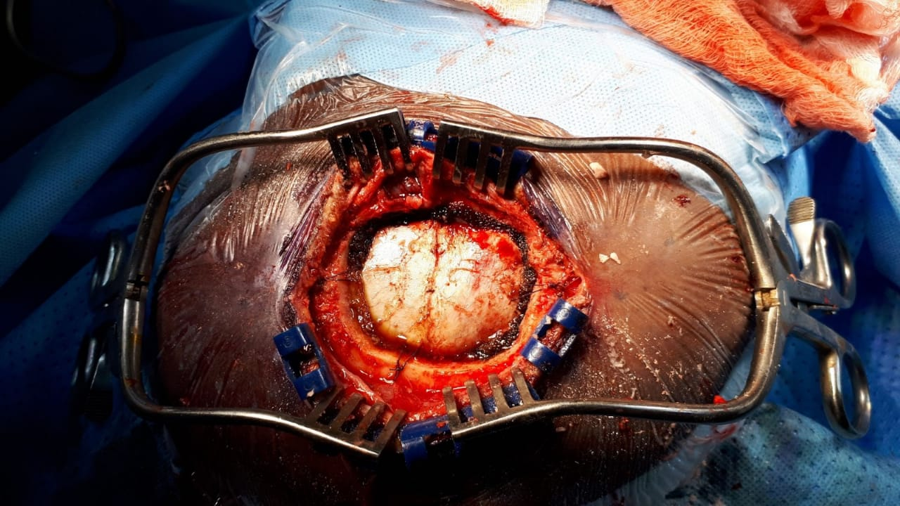
Mini-Craniotomy
DURA

Slide 45
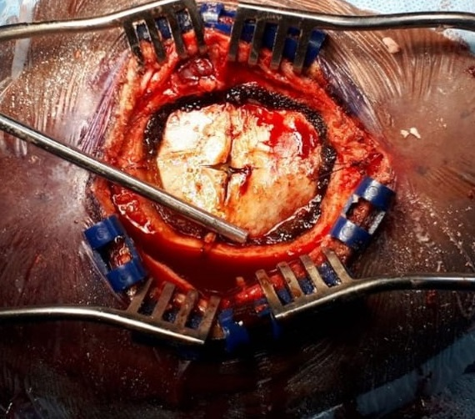
DURAL
OPENING

Slide 46
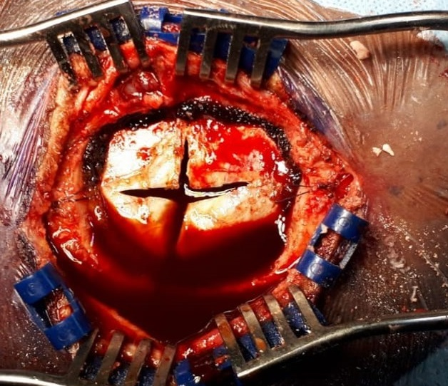
Subdural
haematoma

Slide 47
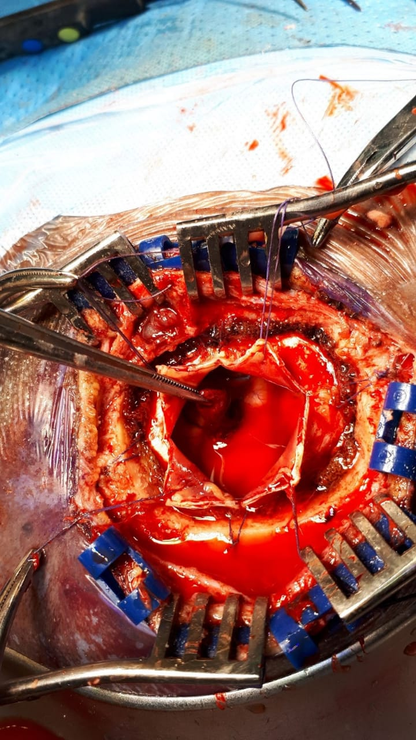
Chronic Subdural Haematoma & pseudomembrane

Slide 48
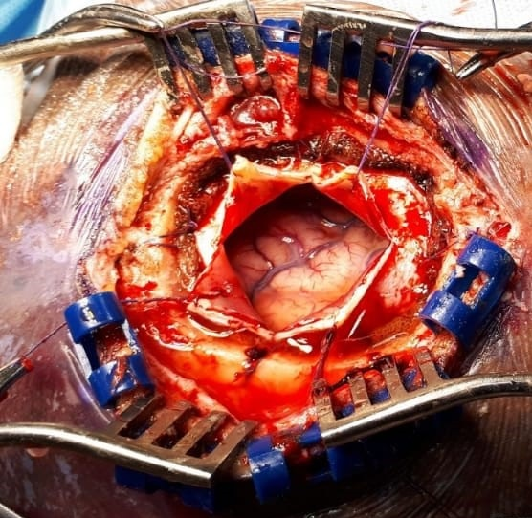
Brain
Dura

Slide 49
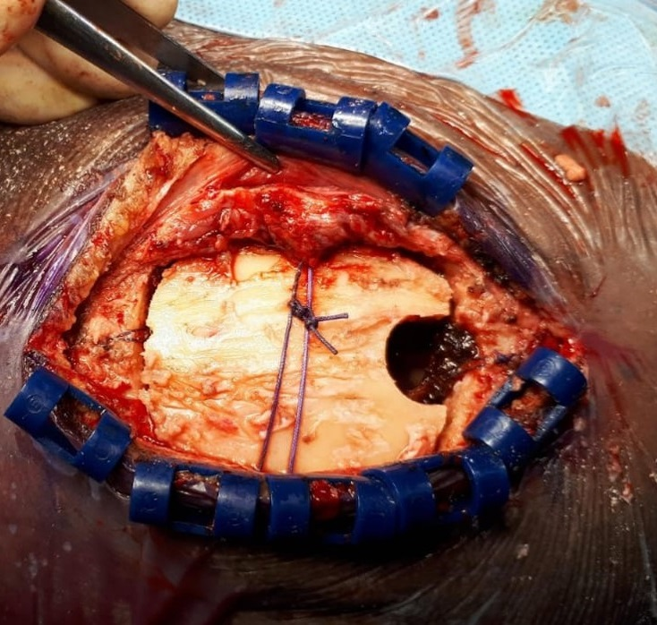
Craniotomy Bone Flap
Burr Hole

Slide 50
Mini Craniotomy
New Development
Brain Glymphatics and Dural Lymphatics
Help to clear potential neuro degenerative toxins, Tau and Amyloid which may be a factor in the development of Dementia

Slide 51
CHRONIC SUBDURAL HEMATOMA
Chronic subdural hematoma should receive greater attention as a potential cause of reversible dementia
Early imaging (plain CT brain) for dementia in elderly patients

Slide 52


Slide 53

When life becomes a headache…
the only painkiller is time…

